Slide 1
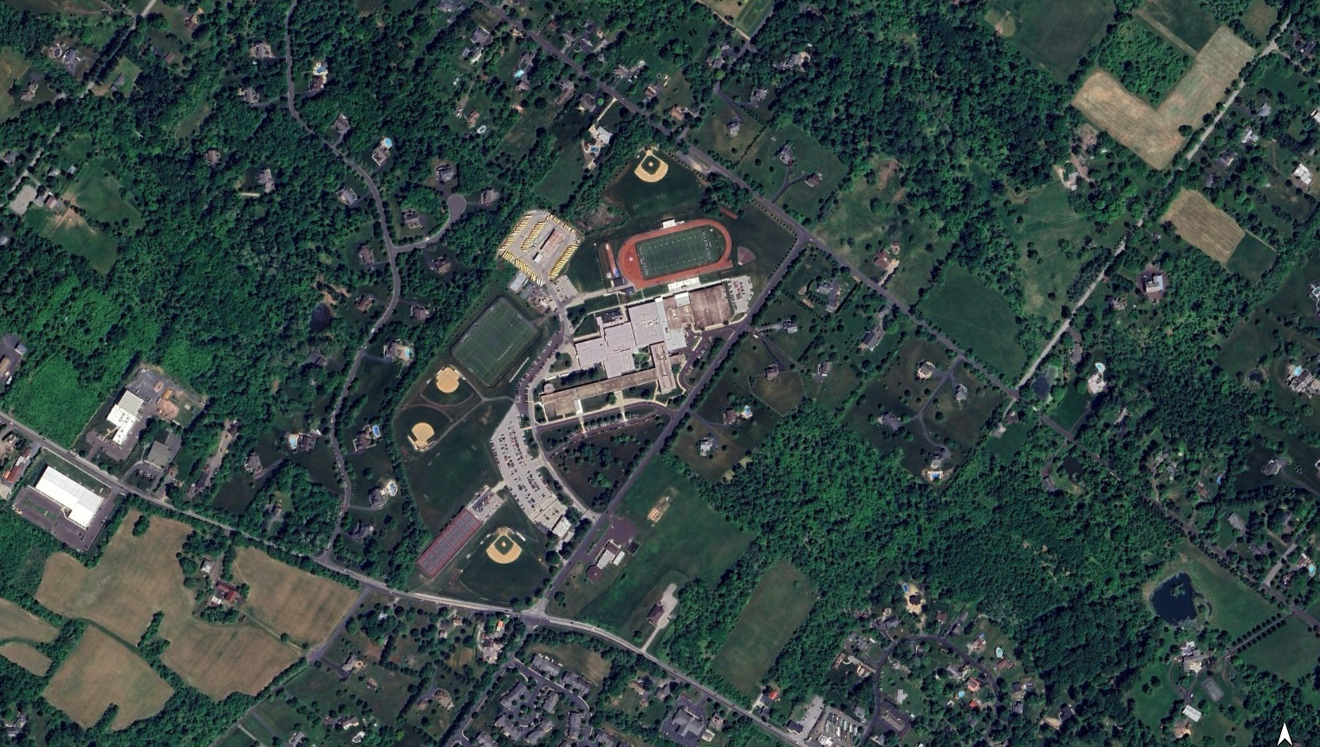
METHACTON
SCHOOL DISTRICT
HIGH SCHOOL CAMPUS PLANNING PROJECT
Schematic Design Update Presentation
28 JANUARY 2025

Slide 2
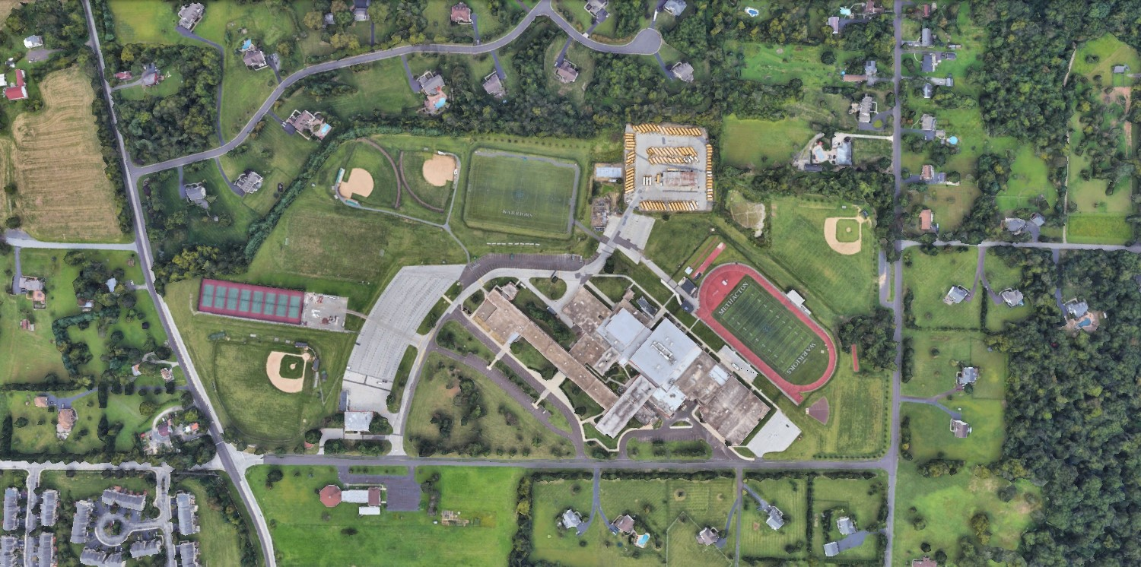
DISCUSSION
01
02
03
01 RECAP
02 CURRENT SITE PLAN
03 PROGRAM AND SCOPE ADJUSTMENTS

Slide 3
01
RECAP
01
02
03
04
METHACTON HIGH SCHOOL
SCHEDULE & COST ESTIMATES

Slide 4
Timeline – Current Design Schedule
MILESTONES DATES BOARD DECISION
2024 - 2025
Schematic Design (SD) 10/29/24 - 3/18/25 3/25/25
Design Development (DD) 3/26/25 - 9/16/25 9/23/25
Approve Act 34 Resolution
ACT 34 Hearing 10/21/25
Construction Documents (CD) 9/17/25 - 1/25/25 January 2026
Bidding 2/6/26 – 3/17/26
Board Approval of Bids March 2026
*Architect and Owner’s Representative will provide monthly progress reports to Board of School Directors
**Schedule is completely contingent on permitting and approval process

Slide 5
Timeline – Construction
MILESTONES DATES
2026 - 2028
Construction May 2026 – December 2028
Building Construction May 2026 – August 2028
Students move to new building December ‘28
Demolition of existing HS January ’29 – March ‘29
Site restoration April ’29 – July ‘29
Project Complete Summer 2029
**Schedule is completely contingent on permitting and approval process

Slide 6
Land Development Status
KEY SUBMISSIONS
2026 - 2028
Worcester Township Meeting – November 11
Sketch Plan Submission – January 7
Infiltration & Geotechnical Testing on-going
NPDES Submission to Montgomery County Conservation District – (March/April)
Traffic Impact Study – starting in February
Meeting with adjacent neighbors – January 13

Slide 7
Zoning Considerations
WORCESTER TOWNSHIP
Public School is a use permitted by Conditional Use in AGR district
CU may or may not be needed since public school is existing use
Zoning Relief likely needed:
Building height – 35 ft, not exceeding 2.5 stories
Impervious surface coverage – limit is 40%, existing is 45%, proposed is 47%
Parking lot(s) within building setbacks – 250 feet front yard
Steep slope disturbance
Varsity baseball/softball field lighting; also requires Conditional Use
Height of parking lot lighting (12’ max)
Parking, Traffic, and Speeding are all areas of concern and are viewed as opportunities for improvement. Off-site parking should be eliminated if possible with increased parking on the campus.

Slide 8
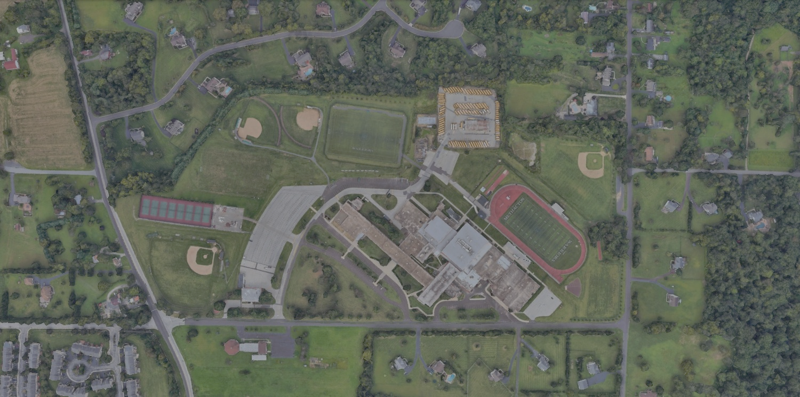
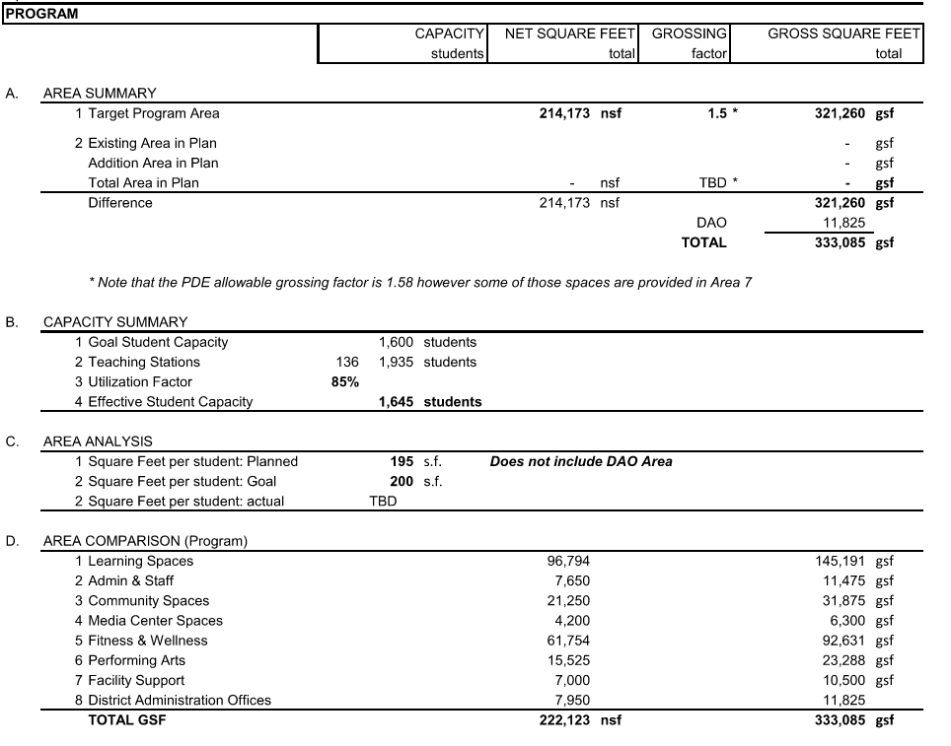

Slide 9
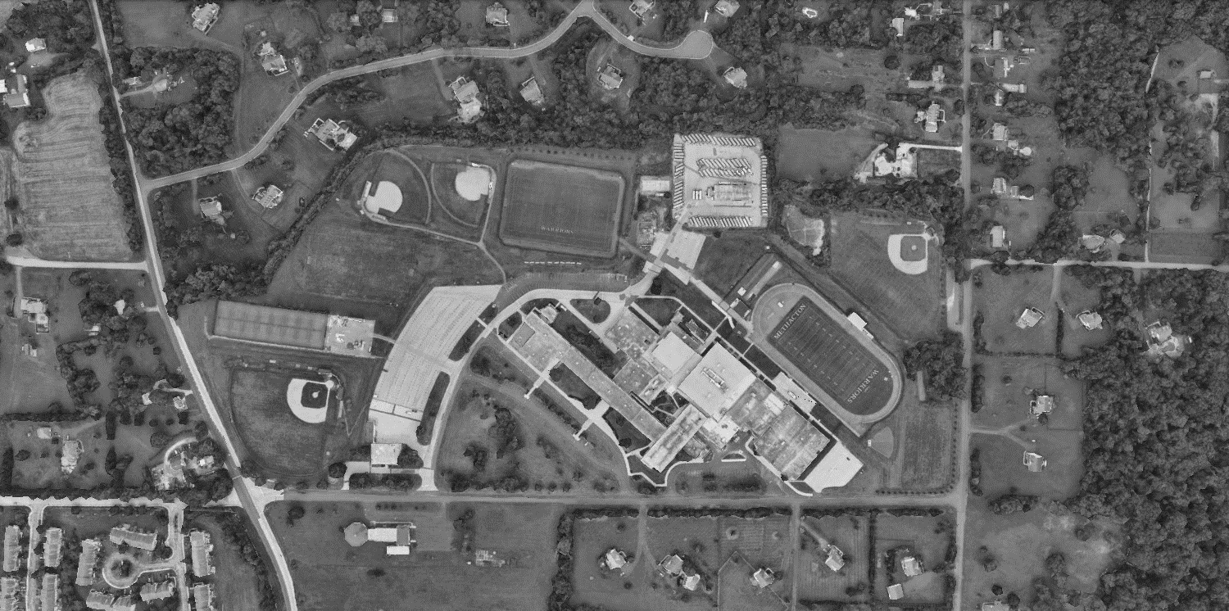
COST ESTIMATES
HARD COSTS Low Range High Range
New H.S. Building Construction $120,250,000 $130,000,000
Utilities (Water, Sewer, Storm, Gas) $ 13,600,000 $ 13,600,000
Site Excavation and Improvements $ 12,600,000 $ 12,600,000
Athletic Facilities Improvements $ 6,612,000 $ 6,894,000
Abatement & Demolition: HS & Farina $ 3,725,000 $ 4,225,000
Offsite Road Improvements & Phasing Costs $ 1,050,000 $ 1,050,000
$157,837,000 $168,369,000
SOFT COSTS
Fees and Land Development $ 14,729,000 $ 15,525,000
Technology, Fixtures & Equipment $ 4,500,000 $ 4,500,000
Design & Construction Contingency $ 12,626,000 $ 13,470,000
Escalation at 3% Annually $ 16,416,000 $ 17,464,000
$ 48,271,000 $ 50,959,000
Total Project Budget $206,108,000 $219,328,000

Slide 10
Other Opportunities for Input
Land Development Approval Process – Township Planning and Supervisors meetings
County Conservation District (NPDES) approvals
Teacher meetings for space design
Student input sessions
Parent / Community presentations of project progress
Web-hosted project image updates
10

Slide 11
02
CURRENT PLANS
01
02
03
04
METHACTON HIGH SCHOOL
SITE PLANS

Slide 12
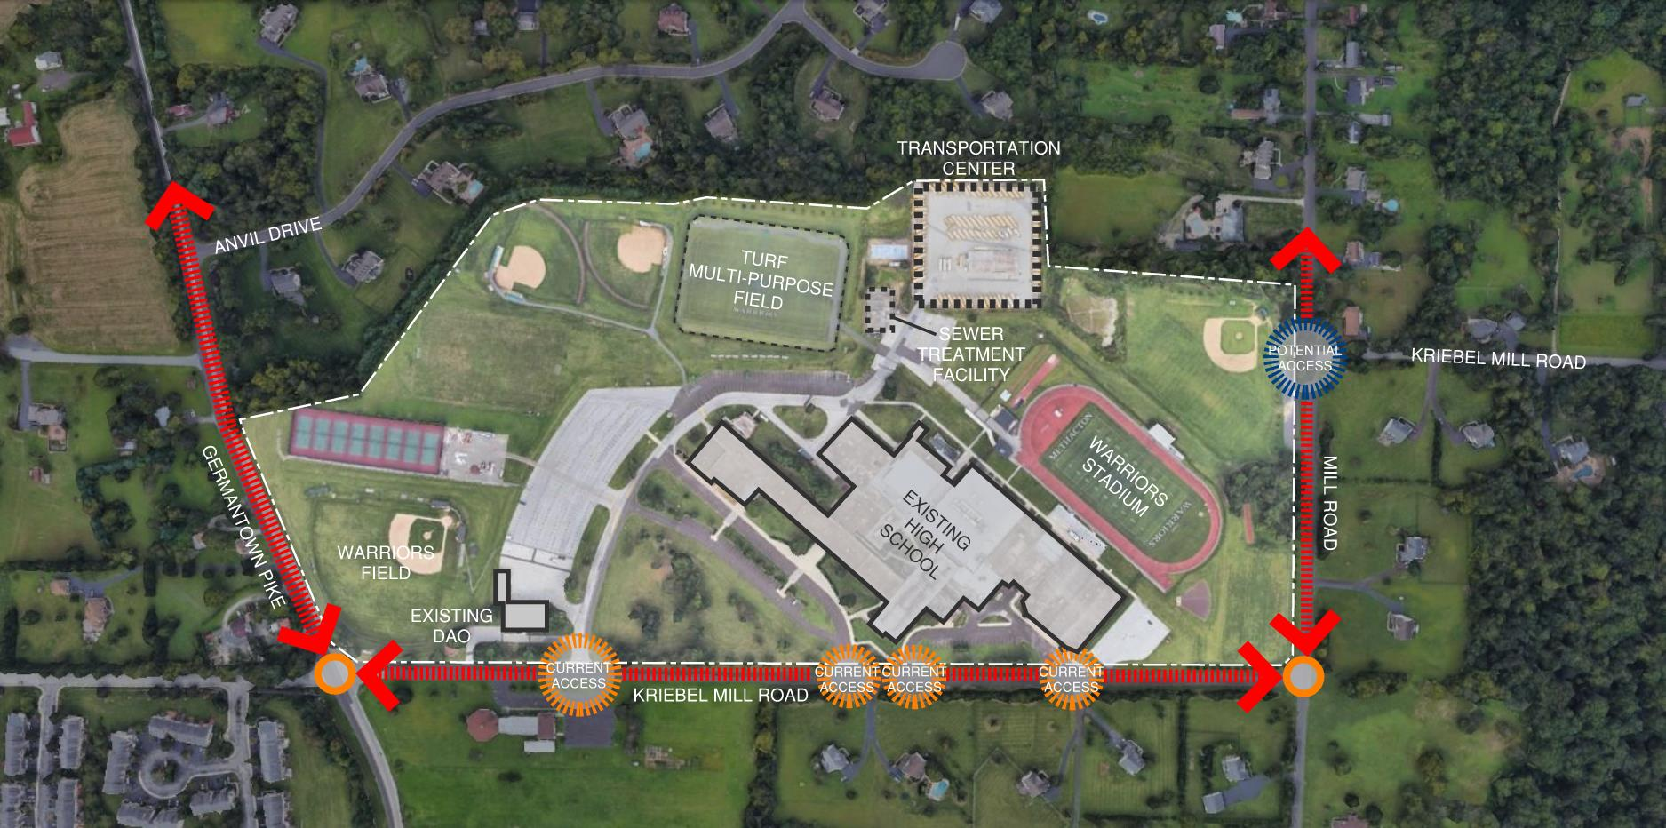
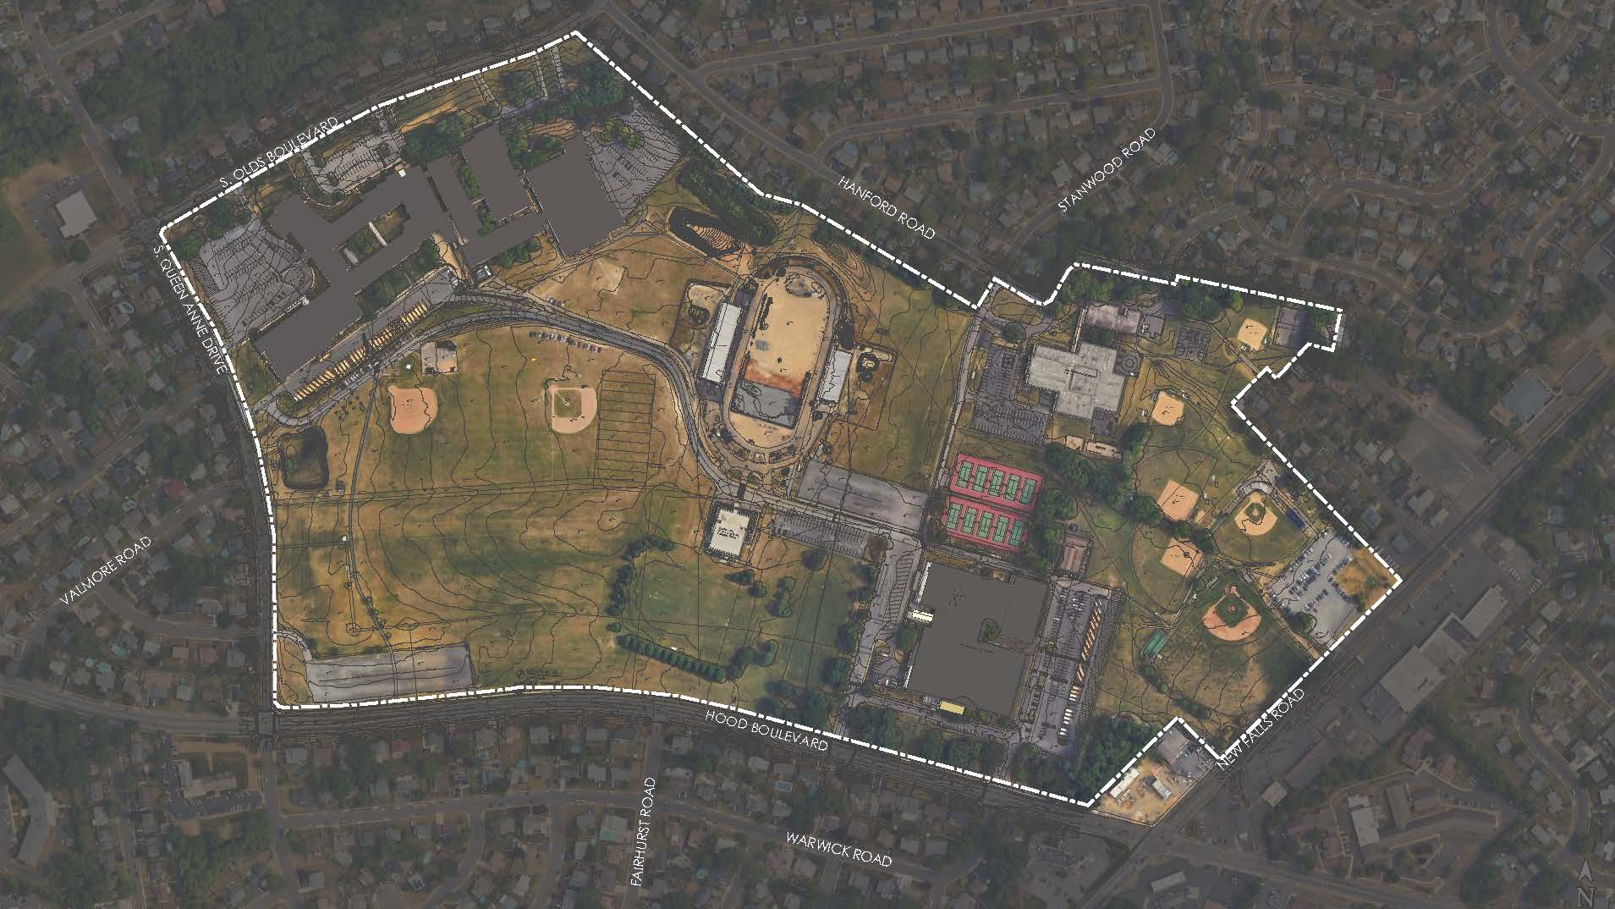

Slide 13
NON- BUILDABLE AREA
NON- BUILDABLE AREA
DEVELOPMENT AREA
NON- BUILDABLE AREA
NON- BUILDABLE AREA
NON- BUILDABLE AREA
NORTH

Slide 14
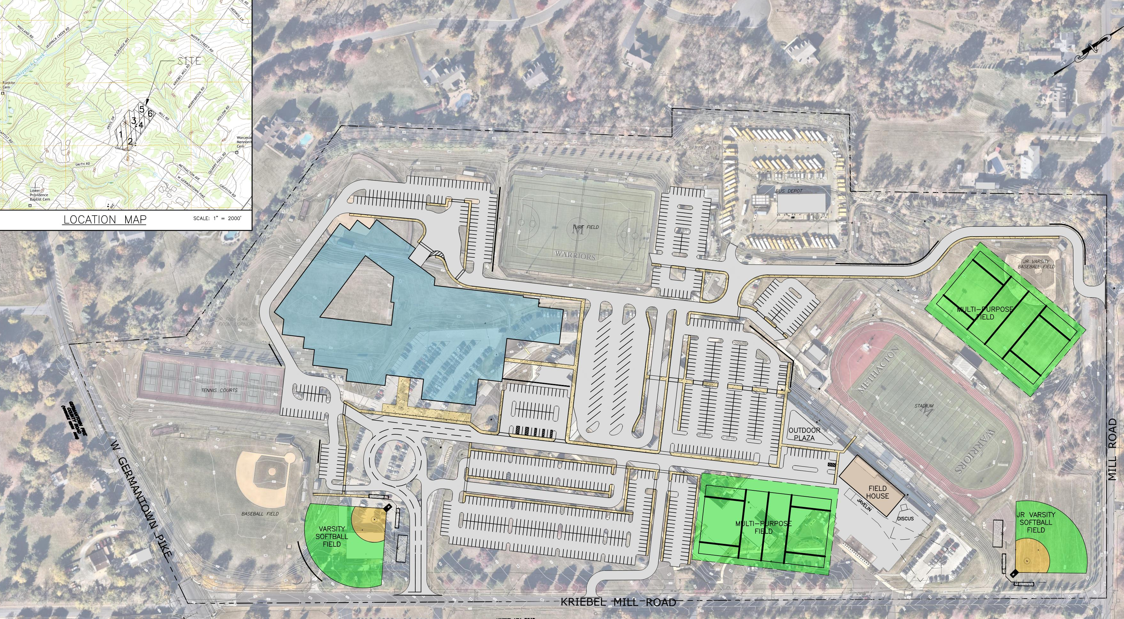
PROPOSED REVISED SITE PLAN
TRANSPORTATION
EXISTING
MULTI-PURPOSE FIELD
ABOVE GROUND SWM BASIN
NEW HS BUILDING
BUS DROP-OFF
EXISTING TENNIS COURTS
EXISTING STADIUM
PARENT DROP-OFF
STUDENT PARKING
NEW
FIELDHOUSE
EXISTING
BASEBALL FIELD
FIELD EVENTS
OPTION 1 – SITE CIRCULATION

Slide 15
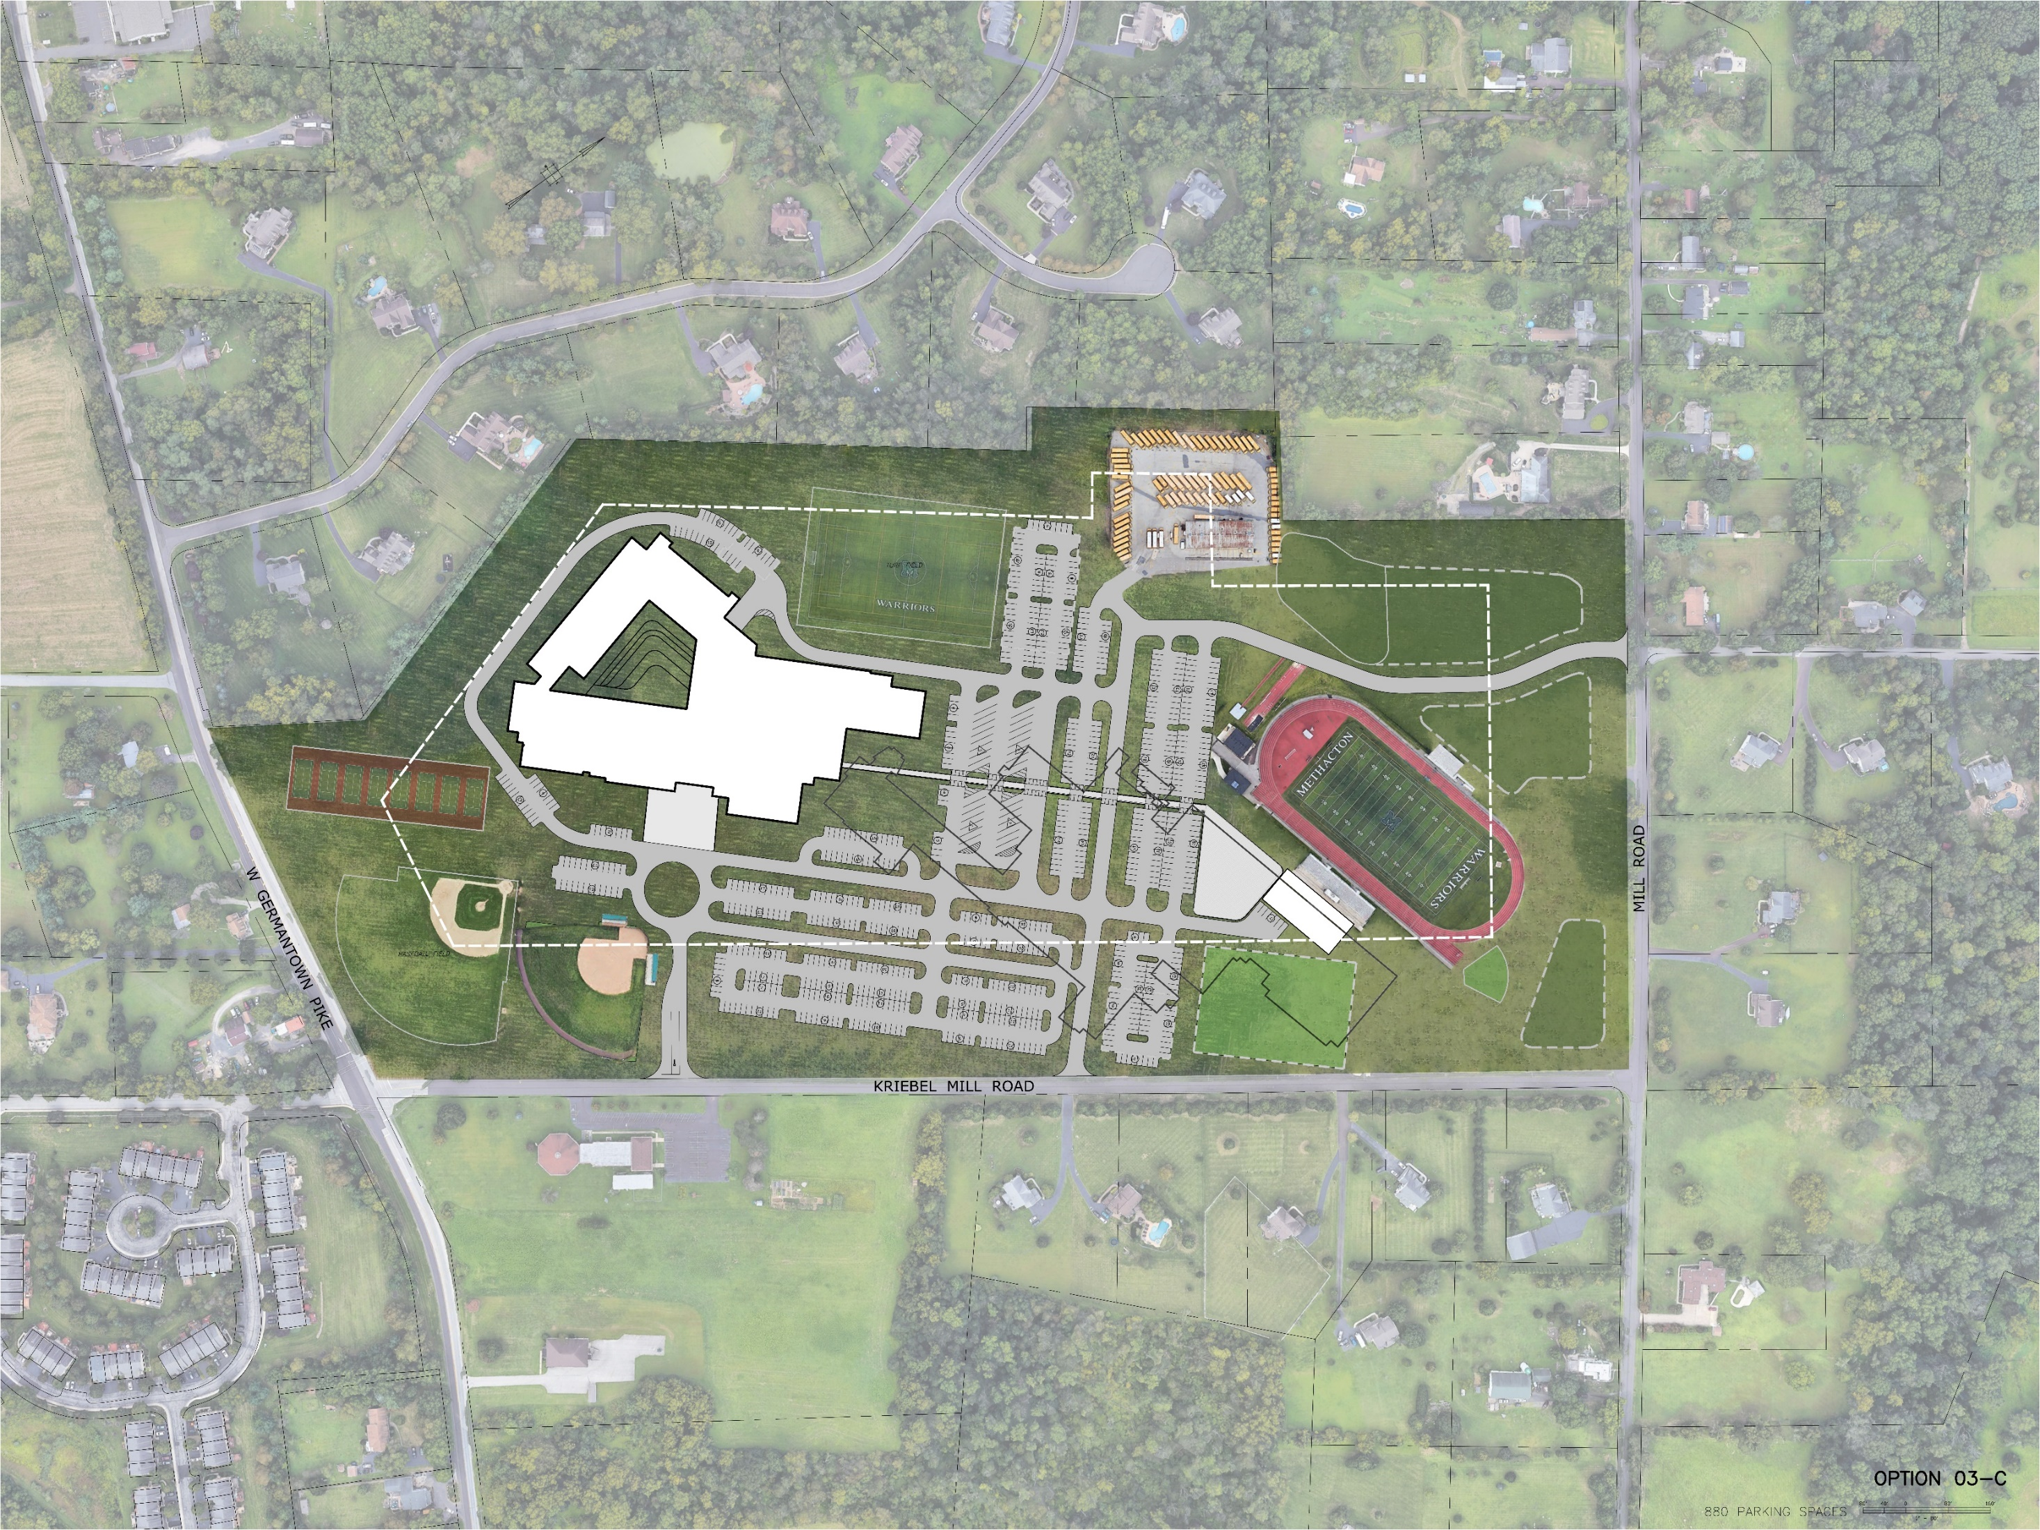
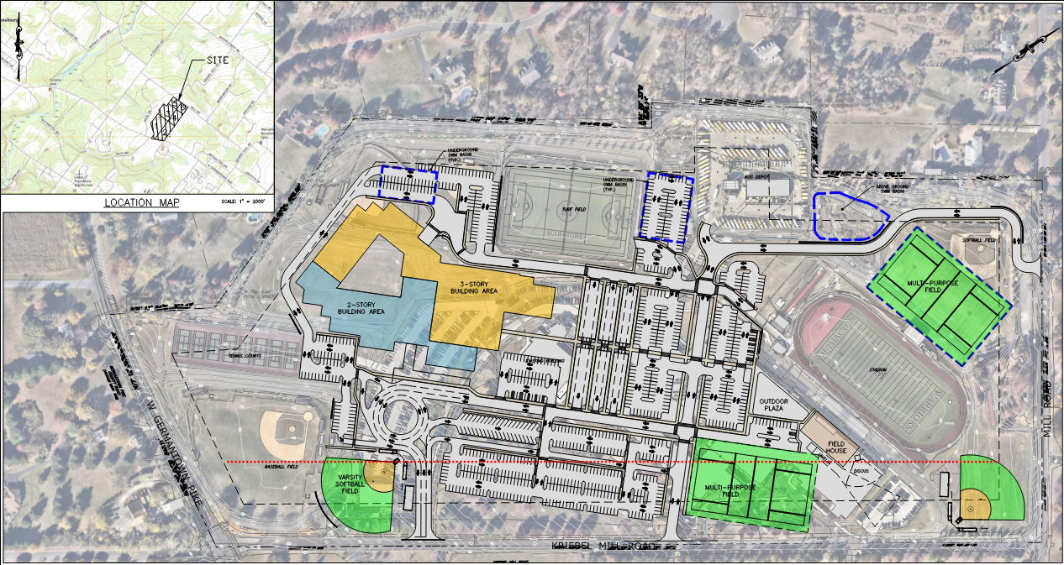
PROPOSED REVISED SITE PLAN
TRANSPORTATION
EXISTING
MULTI-PURPOSE FIELD
ABOVE GROUND SWM BASIN
BUS DROP-OFF
NEW HS BUILDING
ABOVE GROUND SWM BASIN
EXISTING TENNIS COURTS
STUDENT PARKING
EXISTING STADIUM
PARENT DROP-OFF
NEW
FIELDHOUSE
EXISTING
BASEBALL FIELD
FIELD EVENTS
SOFTBALL FIELD
MULTI-PURPOSE FIELD
ABOVE GROUND SWM BASIN
OPTION 1 – SITE CIRCULATION

Slide 16
03
PROJECT & SCOPE ADJUSTMENTS
01
02
03
04
IPC, DAO, SCIENCE LABS, POOL

Slide 17
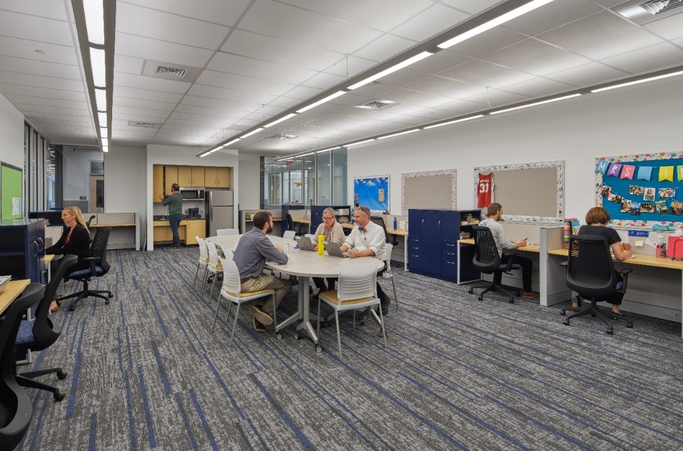
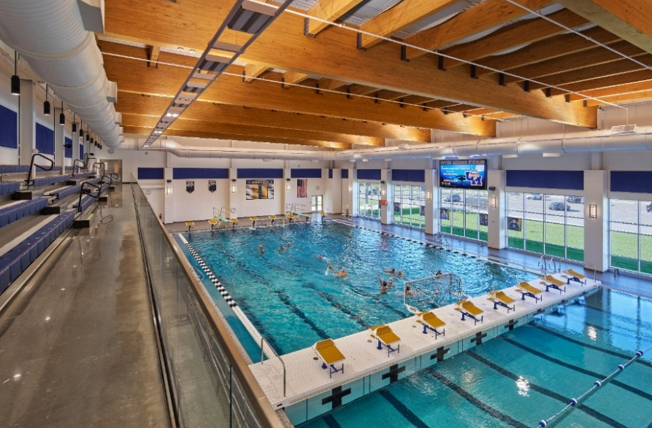
PROJECT & SCOPE ADJUSTMENTS
01 INSTRUCTIONAL PLANNING CENTERS
02 DISTRICT ADMINISTRATION OFFICE
03 SHARED SCIENCE LABS
04 POOL BULKHEAD
LAB
CLASSROOM
CLASSROOM
PREP

Slide 18
QUESTIONS?
28 JANUARY 2025

